Slide 1
The Variational Quantum Eigensolver: A review of methods and best practices

Slide 2
Index
01
Overview of VQE
Pipeline, Advantage, assumptions, limitations
02
Hamiltonian
Electronic Structure Hamiltonian
03
Transforming Fermionic space to spin space
Jordan-Wigner mapping, parity mapping, Bravi-Kitaev, etc.
04
Ansatz selection & Construction
Hardware-efficient ansatz, Unitary Coupled Cluster ansatz

Slide 3
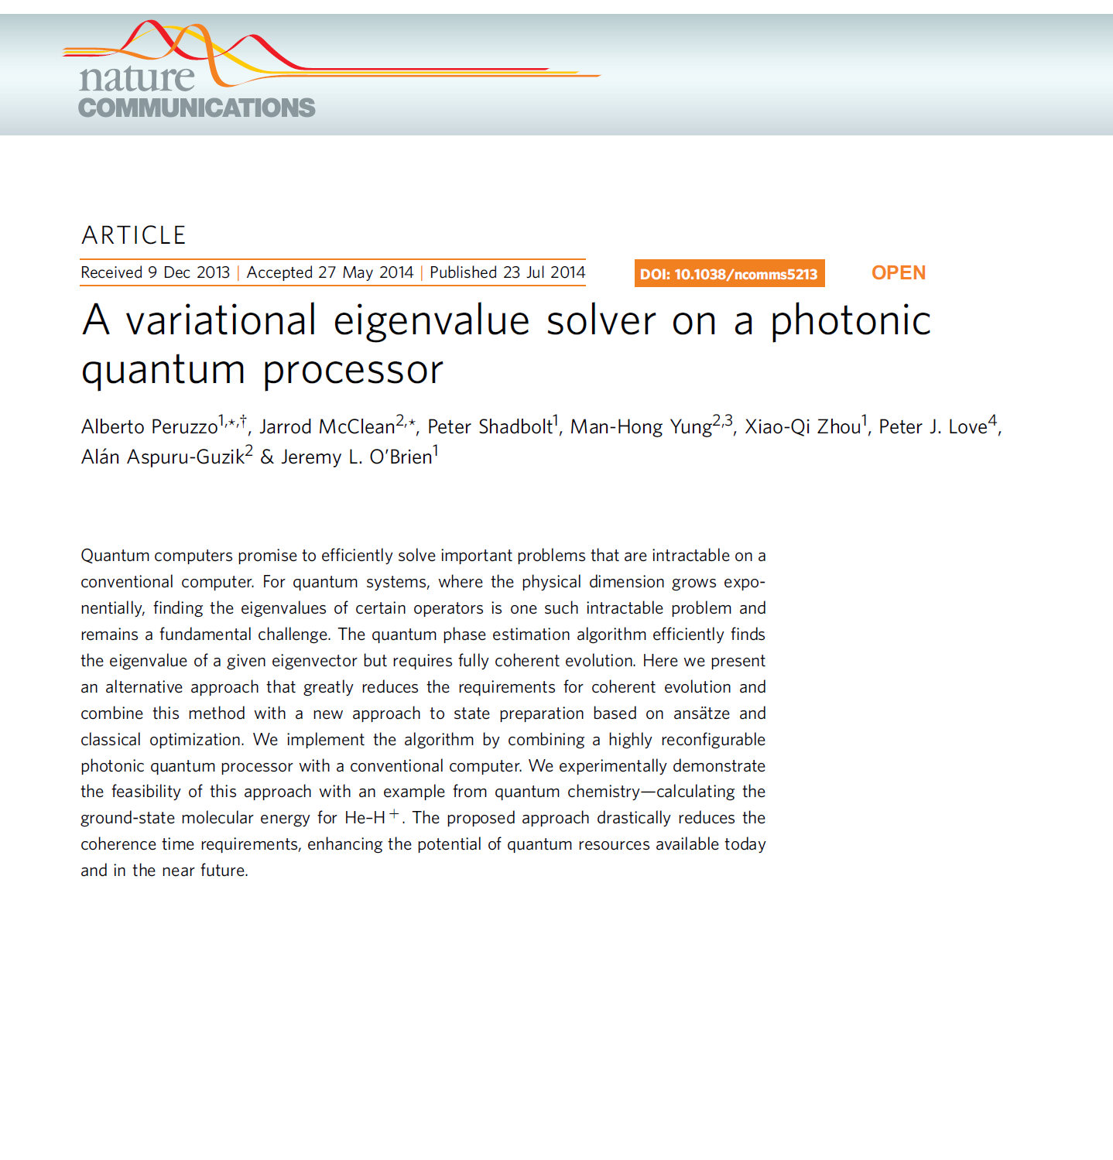
Overview of VQE
Variational
Quantum
Eigensolver

Slide 4
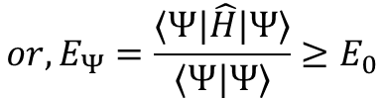
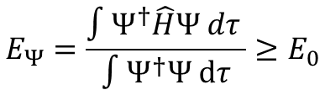
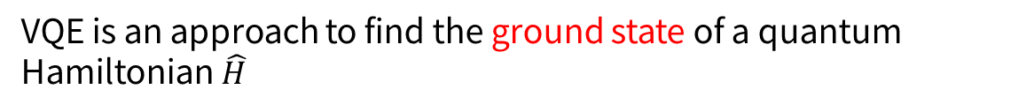
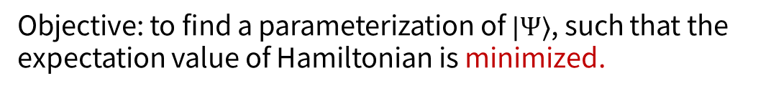
Definitions of VQE
VQE is an approach to find the ground state of a quantum Hamiltonian $\hat{H}$
$$E_{Ψ}=\frac{∫Ψ^{†}\hat{H}Ψ dτ }{∫Ψ^{†}Ψ dτ}≥E_{0}$$
$${or, E}_{Ψ}=\frac{⟨Ψ|\hat{H}|Ψ⟩}{⟨Ψ|Ψ⟩}≥E_{0}$$
Objective: to find a parameterization of $|Ψ⟩$, such that the expectation value of Hamiltonian is minimized.

Slide 5
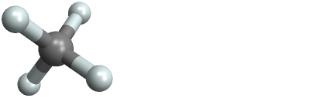
Ground state matters
H
H
H
C
H
H
C
H
Methane(CH4)
H
H
→For a new molecule?

Slide 6

Why use VQE? - NISQ
NISQ (Noisy Intermediate-Scale Quantum) Era
“ NISQ technology will be available in the near future. Quantum computers with 50-100 qubits may be able to perform tasks which surpass the capabilities of today’s classical digital computers, but noise in quantu gates will limit the size of quantum circuits that can be executed reliably. ”
J. Preskill

Slide 7
Physical Error Rate
Where we are today
NISQ
Error Correction threshold
Fault-tolerant QC
# of physical qubits
[J.preskill, Quantum Computing in the NISQ era and beyond, Quantum 2, 79 (2018)]

Slide 8
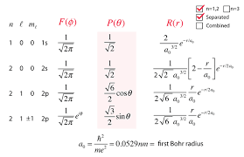
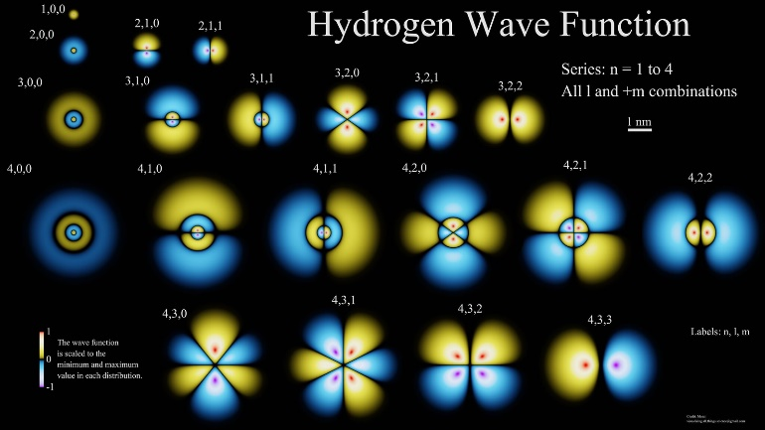

Classical method is hard
$$e^{−}$$
H

Slide 9
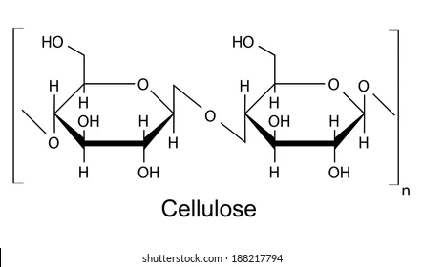
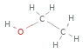
Wavefunctions of complex molecule?
Intractably expensive for accurate calculations on increasingly large systems
→ VQE can be a chivalry!

Slide 10
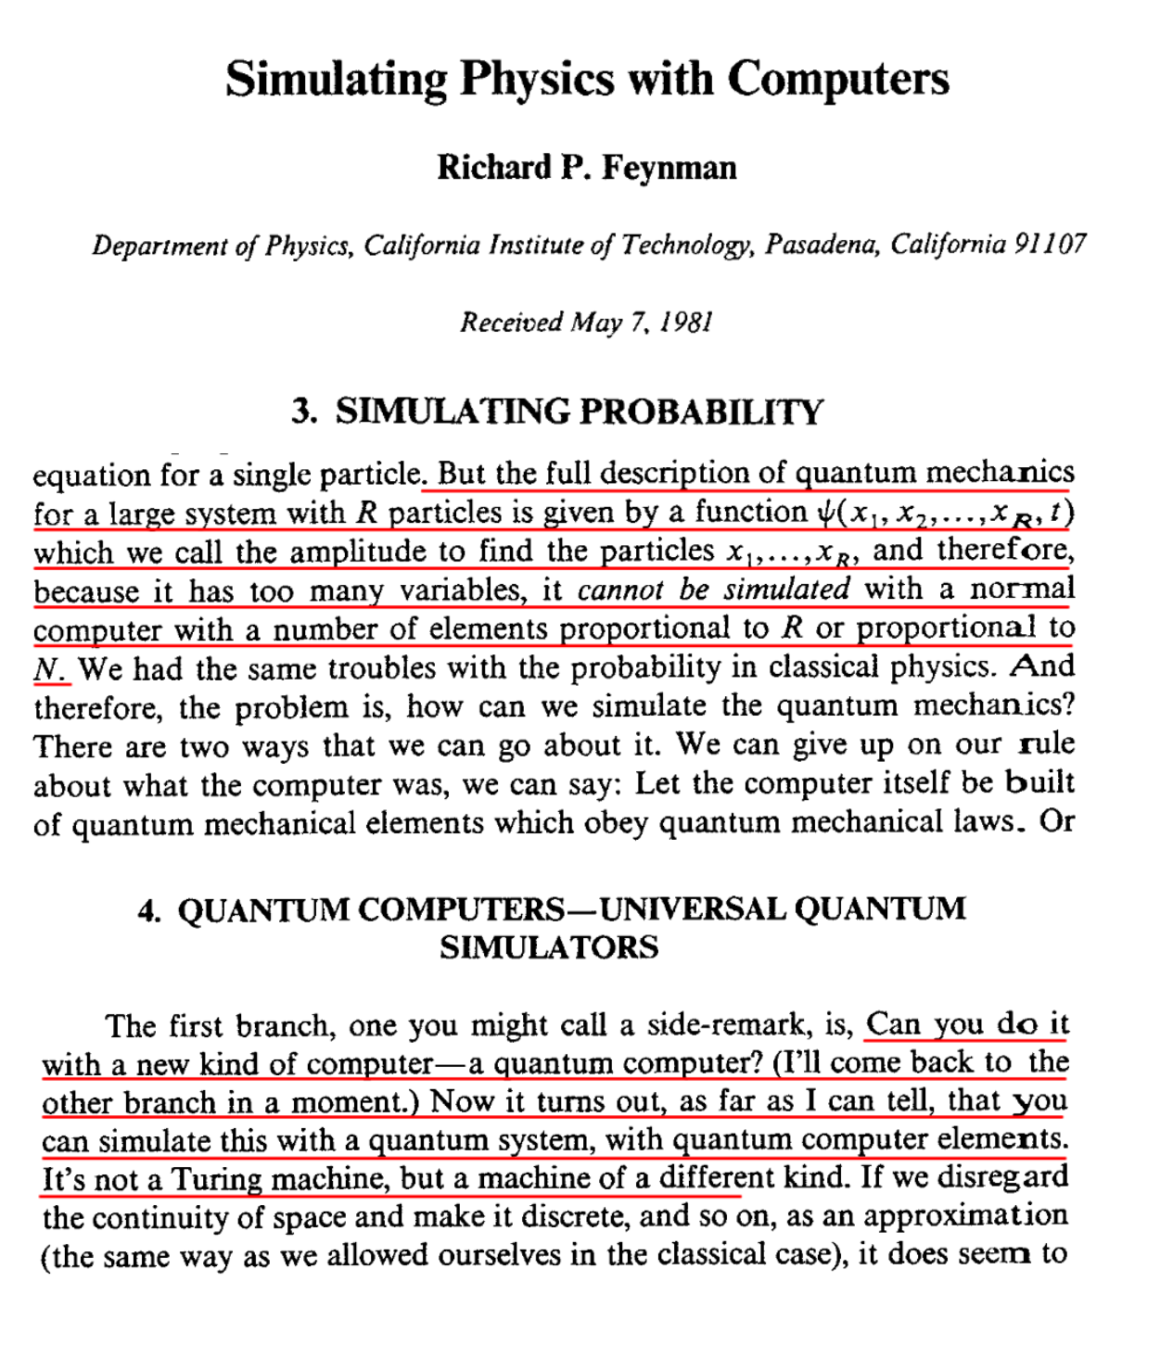
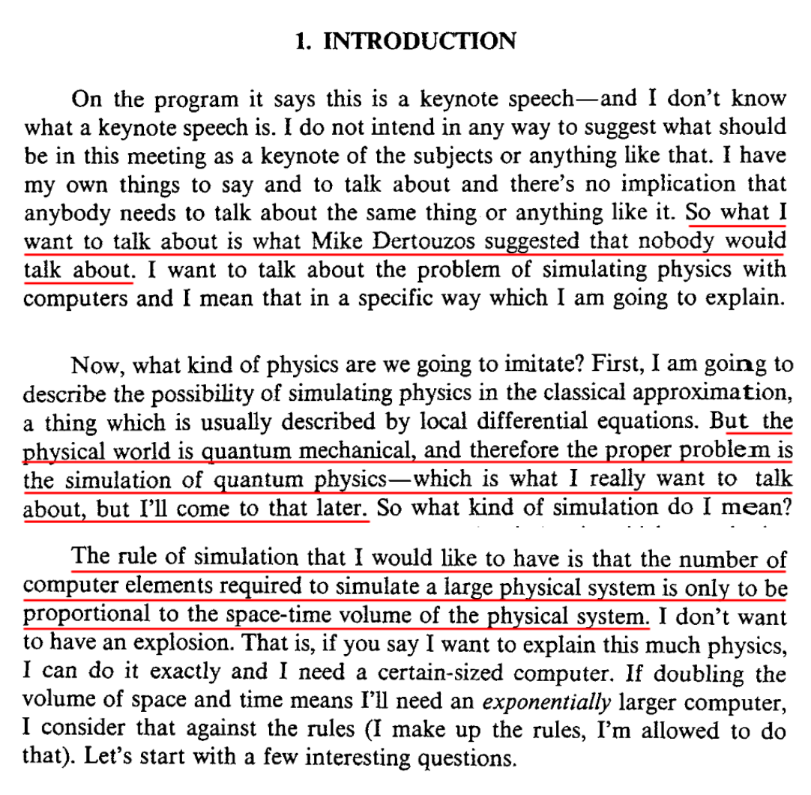
Why VQE is good in NISQ era?

Slide 11
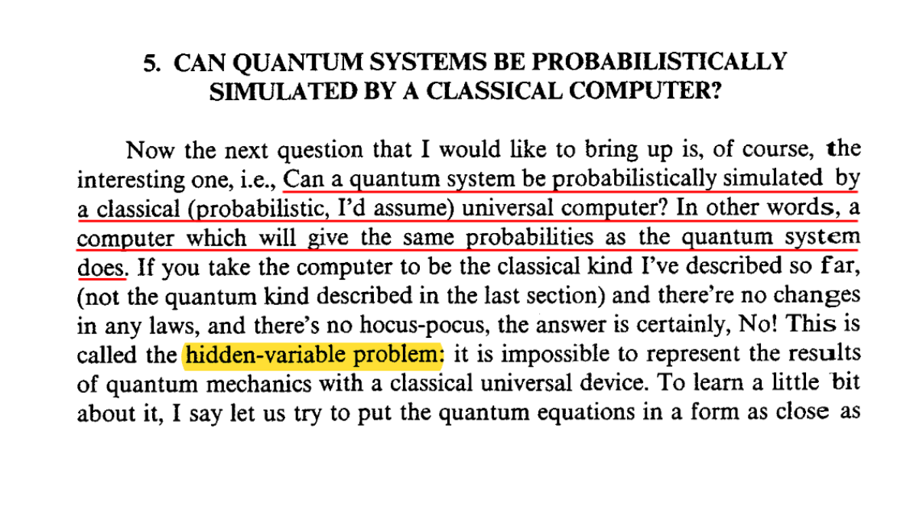
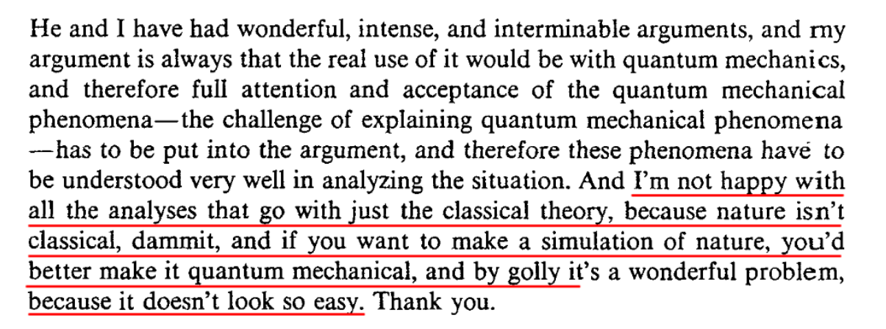

Slide 12
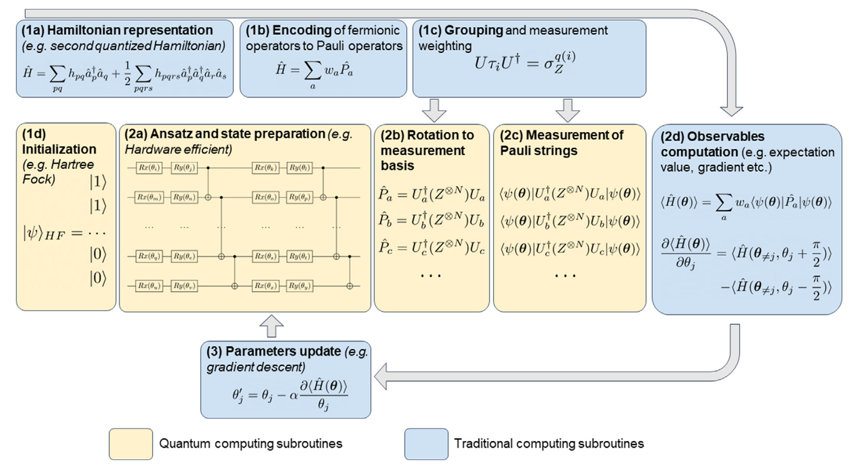
VQE Pipeline

Slide 13
(1) Pre-Processing
1. Hamiltonian representation
2. Encoding
3. Grouping & measurement
4. State initialization
(2) VQE-loop
Ansatz & Trial state
preparation
Basis rotation & measurement
Observable Computation
Parameters update

Slide 14
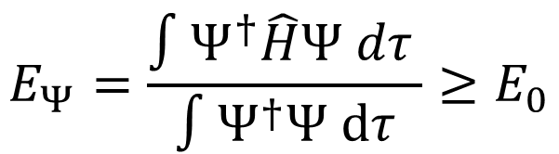
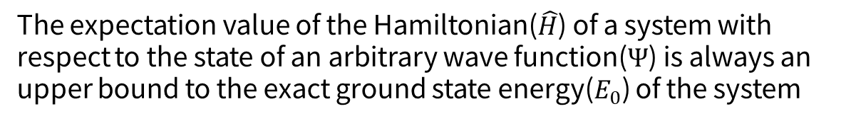
Axiom of VQE
The expectation value of the Hamiltonian($\hat{H}$) of a system with respect to the state of an arbitrary wave function($Ψ$) is always an upper bound to the exact ground state energy($E_{0}$) of the system
$$E_{Ψ}=\frac{∫Ψ^{†}\hat{H}Ψ dτ }{∫Ψ^{†}Ψ dτ}≥E_{0}$$

Slide 15
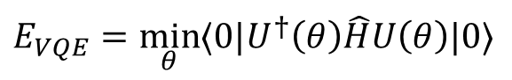
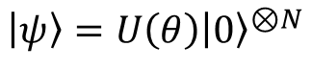
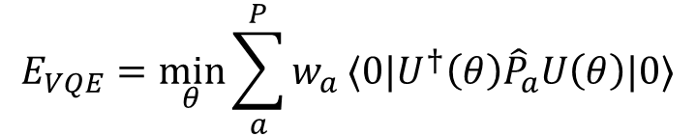
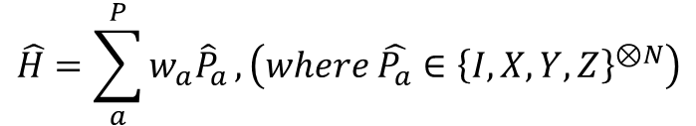
Translating optimization problem to quantum computer
By Applying parameterized unitary operation:
$$\left|ψ\right\rangle =U\left(θ\right){\left|0\right\rangle }^{⊗N}$$
VQE optimization problem can be described as:
$$E_{VQE}=\min_{θ}{⟨0|U^{†}\left(θ\right)\hat{H}U\left(θ\right)|0⟩}$$
Write the Hamiltonian as a weighted sum of spin operators:
$$\hat{H}=\sum_{a}^{P}{w_{a}{\hat{P}}_{a}}, \left(where \hat{P_{a}}∈{\left\{I, X, Y, Z\right\}}^{⊗N}\right)$$
With $w_{a}$ a set of wights, P the number of Pauli strings in the Hamiltonian:
$$E_{VQE}=\min_{θ}{\sum_{a}^{P}{w_{a}}⟨0|U^{†}\left(θ\right){\hat{P}}_{a}U\left(θ\right)|0⟩}$$
Pauli strings:
Quantum Computing OK!

Slide 16
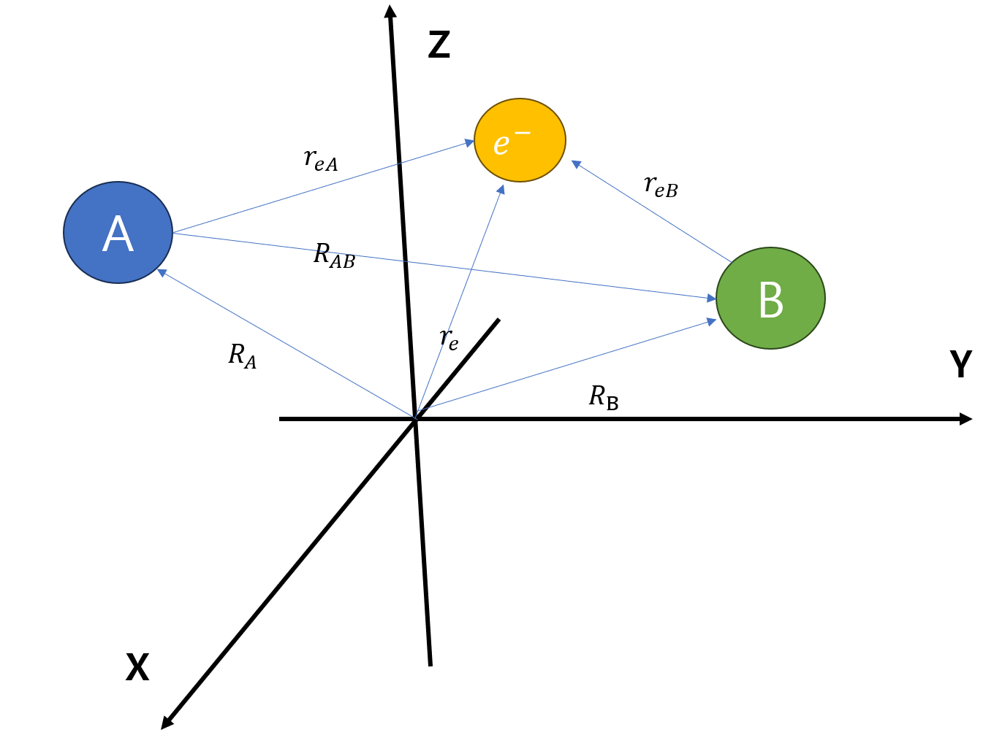
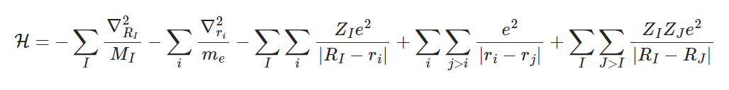
Constructing Hamiltonian

Slide 17
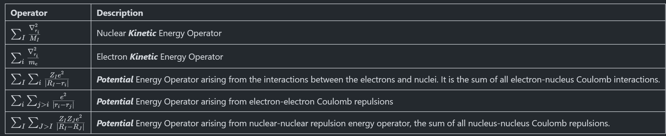
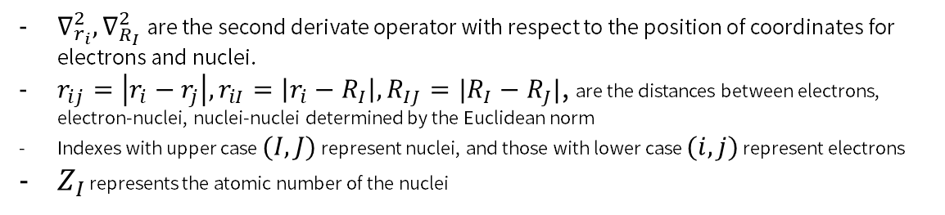
Molecular Hamiltonian
$∇_{r_{i}}^{2}, ∇_{R_{I}}^{2}$ are the second derivate operator with respect to the position of coordinates for electrons and nuclei.
$r_{ij}=\left|r_{i}−r_{j}\right|, r_{iI}=\left|r_{i}−R_{I}\right|, R_{IJ}=|R_{I}−R_{J}|$, are the distances between electrons, electron-nuclei, nuclei-nuclei determined by the Euclidean norm
Indexes with upper case $(I,J)$ represent nuclei, and those with lower case $(i,j)$ represent electrons
$Z_{I}$ represents the atomic number of the nuclei

Slide 18
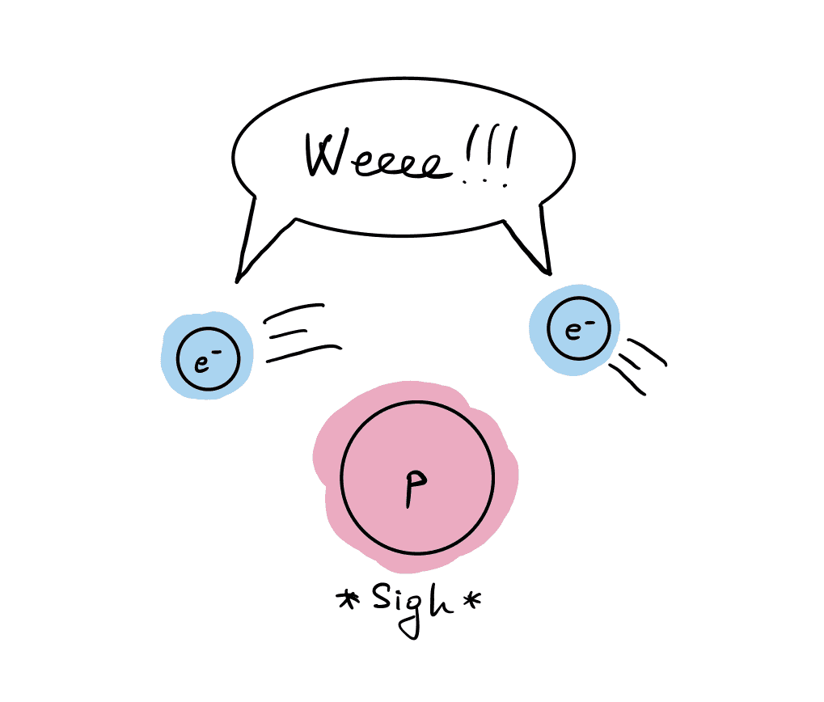
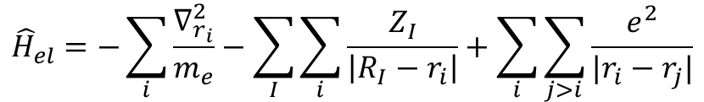
Born-Oppenheimer Approximation
Motions of the nuclei can be uncoupled from the motions of electrons!
$${\hat{H}}_{el}=−\sum_{i}{\frac{∇_{r_{i}}^{2}}{m_{e}}−\sum_{I}{\sum_{i}{\frac{Z_{I}}{\left|R_{I}−r_{i}\right|}}}}+\sum_{i}{\sum_{j>i }{\frac{e^{2}}{|r_{i}−r_{j}|}}}$$

Slide 19
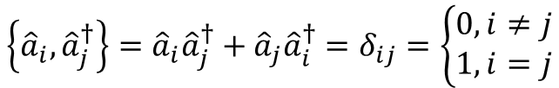
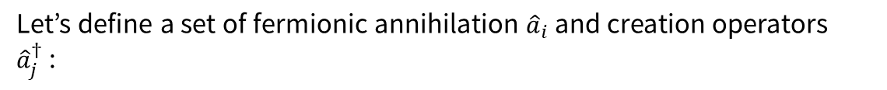

Fermionic Creation and Annihilation Operators
Let’s define a set of fermionic annihilation ${\hat{a}}_{i}$ and creation operators ${\hat{a}}_{j}^{†}$:
$$\left\{{\hat{a}}_{i}, {\hat{a}}_{j}^{†}\right\}={\hat{a}}_{i}{\hat{a}}_{j}^{†}+{\hat{a}}_{j}{\hat{a}}_{i}^{†}=δ_{ij}=\left\{\begin{aligned}0, i≠j \\ 1, i=j\end{aligned}\right.$$
$$\left\{{\hat{a}}_{i}, {\hat{a}}_{i}^{†}\right\}=\left\{{\hat{a}}_{j}, {\hat{a}}_{j}^{†}\right\}=0$$
Where $δ_{ij}$ is the Dirac delta function.
→ Fermionic operator is a linear combination of products of creation & annihilation operators

Slide 20
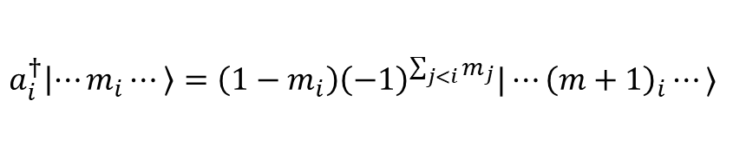
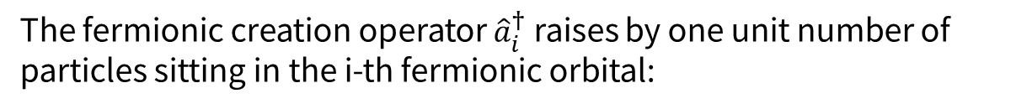
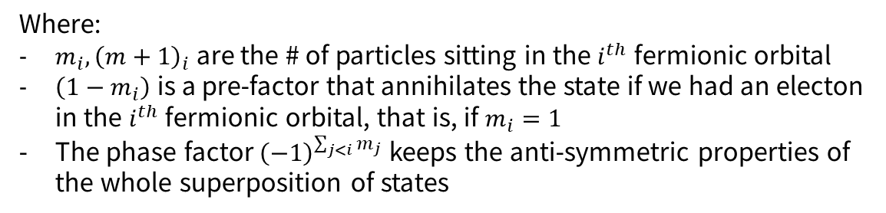
Fermionic Creation Operator
The fermionic creation operator ${\hat{a}}_{i}^{†}$ raises by one unit number of particles sitting in the i-th fermionic orbital:
$$a_{i}^{†}\left|⋯m_{i}⋯\right\rangle =\left(1−m_{i}\right){\left(−1\right)}^{\sum_{j<i}{m_{j}}}|⋯{\left(m+1\right)}_{i}⋯⟩$$
Where:
$m_{i}, {\left(m+1\right)}_{i}$ are the # of particles sitting in the $i^{th}$ fermionic orbital
$\left(1−m_{i}\right)$ is a pre-factor that annihilates the state if we had an electon in the $i^{th}$ fermionic orbital, that is, if $m_{i}=1$
The phase factor ${\left(−1\right)}^{\sum_{j<i}{m_{j}}}$ keeps the anti-symmetric properties of the whole superposition of states

Slide 21
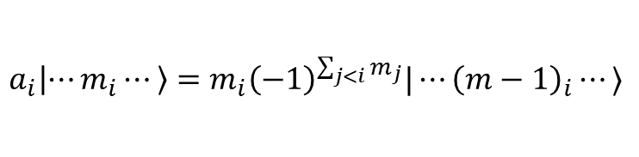

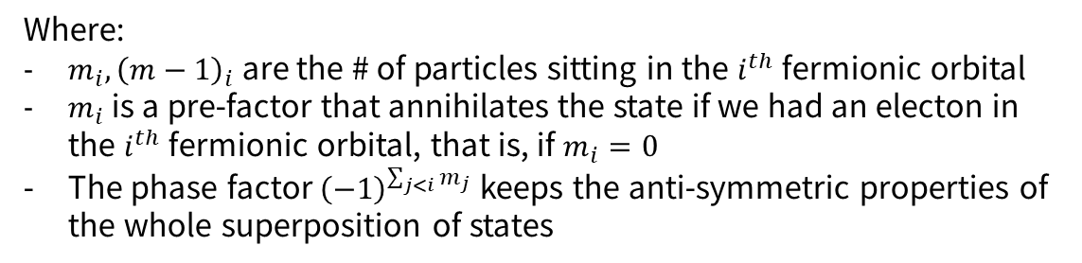
Fermionic Annihilation Operator
The fermionic annihilation operator ${\hat{a}}_{i}^{†}$ lowers by one unit number of particles sitting in the i-th fermionic orbital:
$$a_{i}\left|⋯m_{i}⋯\right\rangle =m_{i}{\left(−1\right)}^{\sum_{j<i}{m_{j}}}|⋯{\left(m−1\right)}_{i}⋯⟩$$
Where:
$m_{i}, {\left(m−1\right)}_{i}$ are the # of particles sitting in the $i^{th}$ fermionic orbital
$m_{i}$is a pre-factor that annihilates the state if we had an electon in the $i^{th}$ fermionic orbital, that is, if $m_{i}=0$
The phase factor ${\left(−1\right)}^{\sum_{j<i}{m_{j}}}$ keeps the anti-symmetric properties of the whole superposition of states

Slide 22
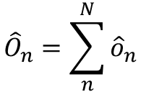
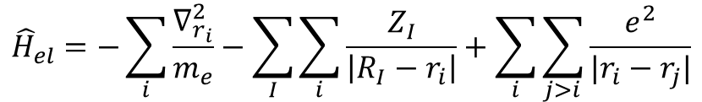
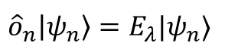
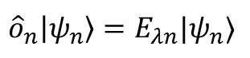
First Quantization
$${\hat{H}}_{el}=−\sum_{i}{\frac{∇_{r_{i}}^{2}}{m_{e}}−\sum_{I}{\sum_{i}{\frac{Z_{I}}{\left|R_{I}−r_{i}\right|}}}}+\sum_{i}{\sum_{j>i }{\frac{e^{2}}{|r_{i}−r_{j}|}}}$$
$${\hat{O}}_{n}=\sum_{n}^{N}{{\hat{o}}_{n}}$$
Single electron hamiltonian
$${\hat{o}}_{n}\left|ψ_{n}\right\rangle =E_{λn}|ψ_{n}⟩$$
Single electron hamiltonian
$${\hat{o}}_{n}\left|ψ_{n}\right\rangle =E_{λ}|ψ_{n}⟩$$

Slide 23
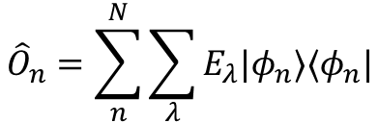
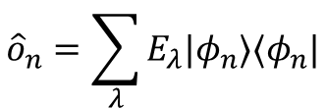
If all eigenstates are orthonormal…
$${\hat{o}}_{n}=\sum_{λ}{E_{λ}|φ_{n}⟩⟨φ_{n}|}$$
$${\hat{O}}_{n}=\sum_{n}^{N}{\sum_{λ}{E_{λ}|φ_{n}⟩⟨φ_{n}|}}$$
This is called first quantization

Slide 24
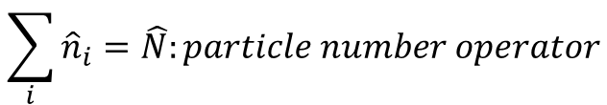
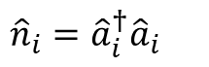
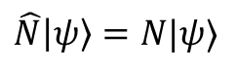
Second Quantization
Aim: Translate electron-based eq to orbital-based eq.
Let’s define “occupation number operator”
$${\hat{n}}_{i}={\hat{a}}_{i}^{†}{\hat{a}}_{i}$$
Apply the operator on every orbitals:
$$\sum_{i}{{\hat{n}}_{i}}=\hat{N}:particle number operator$$
$$\hat{N}\left|ψ\right\rangle =N|ψ⟩$$
$$N:number of all electrons in the molecule$$

Slide 25
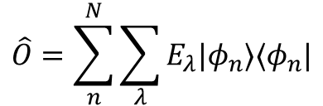
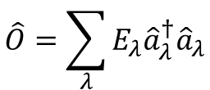
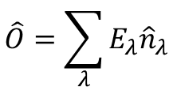
$$\hat{O}=\sum_{n}^{N}{\sum_{λ}{E_{λ}|φ_{n}⟩⟨φ_{n}|}}$$
← Whether each electrons occupy the orbital $λ?$
$$\hat{O}=\sum_{λ}{E_{λ}{\hat{n}}_{λ}}$$
Rewirte into fermionic operator:
$$\hat{O}=\sum_{λ}{E_{λ}{\hat{a}}_{λ}^{†}{\hat{a}}_{λ}}$$

Slide 26
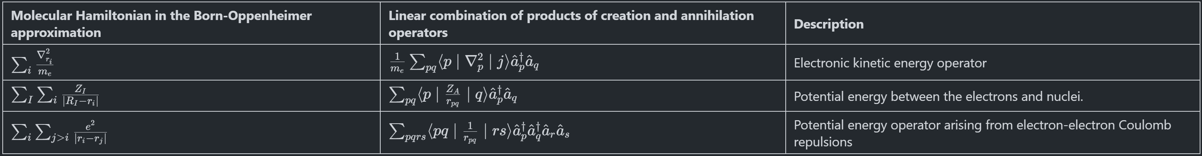
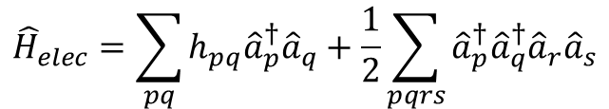
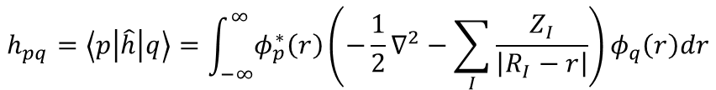
Molecular Hamiltonian in the Hatree-Fock orbital basis
$${\hat{H}}_{elec}=\sum_{pq}{h_{pq}{\hat{a}}_{p}^{†}{\hat{a}}_{q}}+\frac{1}{2}\sum_{pqrs}{{\hat{a}}_{p}^{†}{\hat{a}}_{q}^{†}{\hat{a}}_{r}{\hat{a}}_{s}}$$
$$h_{pq}=\left\langle p\left|\hat{h}\right|q\right\rangle =\int_{−∞}^{∞}{φ_{p}^{∗}\left(r\right)}\left(−\frac{1}{2}∇^{2}−\sum_{I}{\frac{Z_{I}}{\left|R_{I}−r\right|}}\right)φ_{q}\left(r\right)dr$$
$$h_{pqrs}=\left\langle pq\left|\hat{h}\right|rs\right\rangle =\int_{−∞}^{∞}{\int_{−∞}^{∞}{\frac{φ_{p}^{∗}\left(r_{1}\right)φ_{q}^{∗}\left(r_{2}\right)φ_{r}\left(r_{2}\right)φ_{s}(r_{1})}{|r_{1}−r_{2}|}}}dr_{1}dr_{2}$$

Slide 27
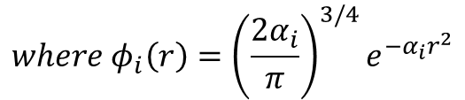
Basis
Define the basis to represent the electronic wave function $|ψ⟩$
e.g., STO-3G basis
$$ψ_{STO−3G}=c_{1}φ_{1}\left(r\right)+c_{2}φ_{2}\left(r\right)+c_{3}φ_{3}(r)$$
$$where φ_{i}\left(r\right)={\left(\frac{2α_{i}}{π}\right)}^{3/4}e^{−α_{i}r^{2}}$$
Gaussian-Type Function
More Basis sets:
https://gaussian.com/basissets/

Slide 28



Slater Type Orbital (STO)
STOs have the same structure as the atomic orbitas of hydrogen-like systems and their radial part have the following form:
$$R_{l}\left(r\right)=A\left(l,α\right)r^{l}e^{−αr}$$
Where:
$l$ is the angular momentum quantum with values ranging from $0 to n−1$, where $n$ is the principal quantum number
$r$ is the nuclear distance of the electron from the atomic nucles
$α$ is called the orbital exponent and controls how fast the density of the orbital vanishes as a function of the nuclear distance

Slide 29


Gaussian Type Orbital (GTO)
GTOs have the same angular form as STOs, but their radial function adopts a Gaussian form, which are easy to be computed:
$$R_{l}\left(r\right)=B\left(l,α\right)r^{l}e^{−αr^{2}}$$
Where:
$l$ is the angular momentum quantum with values ranging from $0 to n−1$, where $n$ is the principal quantum number
$r$ is the nuclear distance of the electron from the atomic nucles
$α$ is called the orbital exponent and controls how fast the density of the orbital vanishes as a function of the nuclear distance

Slide 30
(1) Pre-Processing
1. Hamiltonian representation
2. Encoding
3. Grouping & measurement
4. State initialization
(2) VQE-loop
Ansatz & Trial state
preparation
Basis rotation & measurement
Observable Computation
Parameters update

Slide 31
(1) Pre-Processing
1. Hamiltonian representation
2. Encoding
3. Grouping & measurement
4. State initialization
(2) VQE-loop
Ansatz & Trial state
preparation
Basis rotation & measurement
Observable Computation
Parameters update

Slide 32

Fermion to qubit mapping
Method | Pauli Weight | Comments
Jordan-Wigner | $$O(n)$$ | Orbital occupation → Qubits
Parity | $$O(n)$$ | Orbital parity → Qubits
Bravi-Kitaev | $$O(\log_{2}{n})$$ | Mixed version of Jordan-Wigner & Pairty

Slide 33

Jordan-Wigner Mapping
Occupation of spin orbital ⬄ each qubit
Fermionic creation and annhilation ⬄ tensor product of pauli operations

Slide 34



Example: Creation on k-th orbital
$${\hat{a}}_{k}^{†}:creation operator on k^{th} orbital$$
Transforming into qubit creation op, $σ_{k}^{†}$
+ anti-commutation related parity
$$Z_{0}⊗Z_{1}⊗Z_{2}⊗⋯⊗Z_{k−1}⊗σ_{k}^{†}⊗I_{k+1}⊗⋯⊗I_{N}$$
$$=\frac{1}{2}Z_{0}⊗Z_{1}⊗Z_{2}⊗⋯⊗Z_{k−1}⊗\left(X_{k}−iY_{k}\right)⊗I_{k+1}⊗⋯⊗I_{N}$$
Time complexity: $O(N)$

Slide 35


Parity Mapping
Parity ⬄ Weight
Time complexity: $O(N)$

Slide 36

Bravi-Kitaev Mapping

Slide 37
(1) Pre-Processing
1. Hamiltonian representation
2. Encoding
3. Grouping & measurement
4. State initialization
(2) VQE-loop
Ansatz & Trial state
preparation
Basis rotation & measurement
Observable Computation
Parameters update

Slide 38

Trial wavefunctions

Slide 39




Unitary Couple Cluster Ansatz
Coupled-Cluster: recovering a portion of electron correlation energy after applying Hatree-Fock Method
$$Cluster op: \hat{T}={\hat{T}}_{1}+{\hat{T}}_{2}+⋯+{\hat{T}}_{v}$$
$${\hat{T}}_{1}=\sum_{ia}{t_{i}^{a}{\hat{a}}_{a}^{†}{\hat{a}}_{i}}$$
← Single excitation operator
$${\hat{T}}_{2}=\sum_{ijab}{t_{ij}^{ab}{\hat{a}}_{a}^{†}{\hat{a}}_{b}^{†}{\hat{a}}_{i}{\hat{a}}_{j}}$$
← Double excitation operator
$$CC ansatz wavefunction: \left|ψ\right\rangle =e^{\hat{T}}|ψ_{HF}⟩$$

Slide 40

Unitary Couple Cluster Ansatz
Since T is not always Unitary, we have to change it Unitary. Unitary Coupled Cluster makes Coupled Cluster into Unitary operations:
$$UCC ansatz wavefunction:$$
$$\left|ψ\right\rangle =e^{\hat{T}−{\hat{T}}^{†}}|ψ_{HF}⟩$$

Slide 41

Appliance
VQE convergence on H2

Slide 42

VQE on H2

Slide 43


VQE on LiH

Slide 44

VQE on H2O

Slide 45

VQE: Really Advantageous?
Substantial measurement required
Need to solve optimization problem
Barren plateaus
Still too noisy quantum computer

Slide 46
Thank you

